Slide 1
IT1762
Data Structures & Algorithms
Topic 6
Advanced Data Structures

Slide 2
Objectives
Topics:
Queues, Stacks, Linked Lists, Binary Trees
At the end of the lesson, you should be able to:
  Understand the concept of a queue
  Understand the concept of a stack.
  Understand the concept of a linked list.
  Understand how to traverse a binary tree.

Slide 3
Queue
1
  A queue is a data structure
  It is a linear lists of information that are accessed in First-In-First-Out (sometimes called FIFO)
  items may be inserted at one end (called the rear of queue) and deleted at the other end (called the front of the queue).
rear
Queues
front

Slide 4
  Examples
  A line at a bank cash-online or a group of cars waiting at a toll booth are all familiar example of queue.
Some Queue Methods & Properties
  Enqueue( ) - add an object at the end of the queue
  Dequeue() - remove an object from the front of the queue
  Clear( ) - removes all objects in the queue.
  Contains( ) – checks if an element is in the queue.
  Count - get number of elements in the queue (property)
  (go to self-study materials for a full list
  of queue methods and properties)

Slide 5
MSDN website
About Queue Object
Visit the online MSDN library
http://msdn.microsoft.com/en-us/library/system.collections.queue.aspx
List the Queue Class
  Members, Methods and Properties
Visit the Queue Class Object and learn about its method and properties

Slide 6
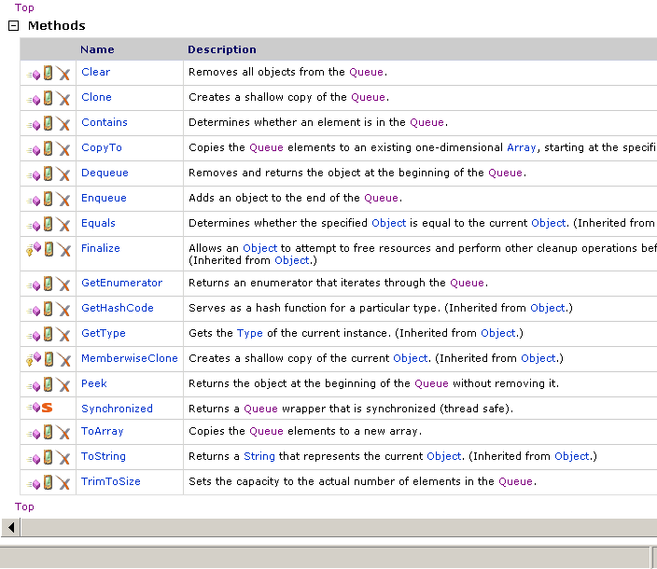
Let’s review the Methods in Queue class e.g Dequeue (), Enqueue()

Slide 7
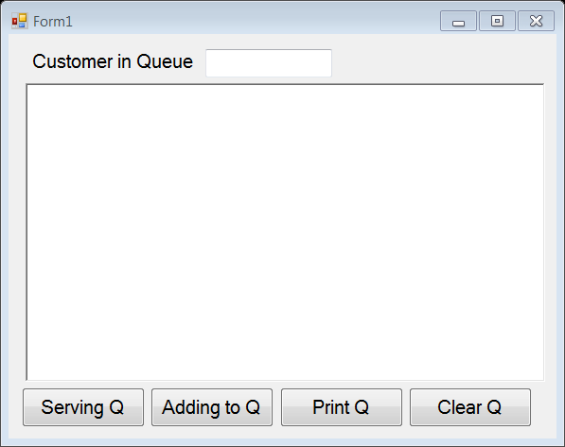
Example1:
Application of Queue
Queues are used to simulate situations where people have to wait in line. One scenario is to create a new Queue object to store name of customers in a queue waiting to be served.
Program reads in customer’s name who is waiting in the queue
Implement a Queue class to do the following :
  Serving Queue
  Adding to Queue
  Print Queue
  Clear Queue

Slide 8
Example1:
Application of Queue
using System.Collections; // where Queue object is
To use the Queue Class Object
To create a new Queue Object
// class Queue
Queue myQueue = new Queue(); // create a queue
private void BtnServing_Click(object sender, EventArgs e)
{
string servingName;
// there is item in queue
if (myQueue.Count!=0)
{
servingName = (string) myQueue.Dequeue();
rtbResult.AppendText(" It is serving " + servingName + "\n");
}
else
{
rtbResult.AppendText(" Queue is emptied. \n");
}
}
To serve a Customer from the myQueue
Cast the object to string type
When user clicks on Serving Queue button, program checks there is any item in the queue. If true, program call Dequeue method to remove the item.

Slide 9
Example1:
Application of Queue
To add a Customer into the myQueue
private void btnAdd_Click(object sender, EventArgs e)
{
string qname =txtQueueName.Text ;
myQueue.Enqueue(qname);
rtbResult.AppendText(" Adding " + qname + " into queue \n");
}
private void BtnPrint_Click(object sender, EventArgs e)
{
rtbResult.AppendText(" Items in queue are: ");
// printing all items
foreach (string item in myQueue)
{
rtbResult.AppendText(item + " ");
}
}
private void btnClear_Click(object sender, EventArgs e)
{
myQueue.Clear(); // clear the queue
}
To print myQueue
To clear myQueue
When user clicks on Adding to Queue button, program reads the customer’s name and add it into queue.
When user clicks on Print Queue button, program print the items from the queue.
When user clicks on Clear Queue button, program empties the queue

Slide 10
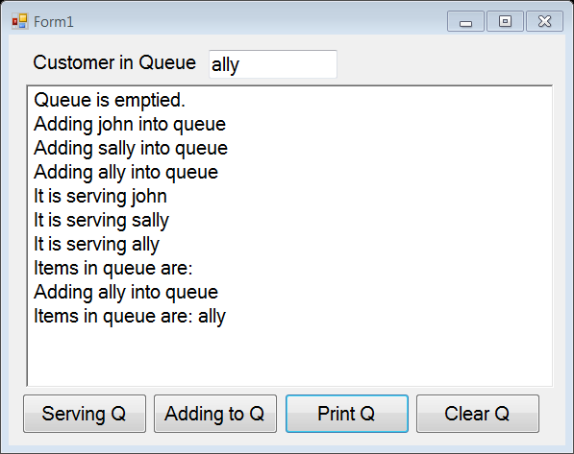
Example1:
Application of Queue
Sample of output with the following action:
  Serving an empty queue
  Add in John,sally and ally
  Serving john, sally and ally
  Print empty queue
  Add ally
  Print queue

Slide 11
2
Stacks
  A stack is a list of items in which items are inserted and deleted at one end, called the top of the stack.
  Example
  Like a stack of pancakes serving on a plate.
    You would start eating from the top of the stack.
    New serving of pancake, will be served on the top of the stack

Slide 12
Stacks – Push & Pop
Insertion and deletion of items are done at the top of the stack
Last-In-First-Out (LIFO)
Two operations - push & pop
G
G
F
G
F
F
F
E
E
E
E
D
D
D
D
C
C
C
C
B
B
B
B
A
A
A
A

Slide 13
Stacks –
Methods & Properties
Push( ) - place an item on the
top of the stack
Pop( ) - remove the item from the
top of the stack
Count - get the number of
elements in the stack
Clear( ) - removes all elements in
the stack.
Peek( ) - return the value of top
item without removing it
(go to self-study materials for a full list of
stack operations)

Slide 14
Stacks – Push & Pop
G
G
F
G
F
F
F
E
E
E
E
D
D
D
D
C
C
C
C
B
B
B
B
A
A
A
A
Push(’F’); Push(’G’); f=full(); i=Pop();

Slide 15
MSDN website
About Stack Object
Visit the online MSDN library
http://msdn.microsoft.com/en-us/library/system.collections.stack.aspx
List the Stack Class
  Members, Methods and Properties
Visit the Stack Class Object and learn about its method and properties

Slide 16
3
Linked Lists
A Linked List is a dynamic data structure.
  i.e. storage can grow and shrink according to needs without restriction (apart from physical memory constraints).
It consists of objects called nodes that are logically linked
Each node contains at least 2 fields:
- one field contains the address of the next node
- other fields contain information
info next
info next
info next
info next
list
node
node
node
node

Slide 17
Linked Lists Operations
Insertion
Adding a node at the
front of the linked list
info next
p
6
info next
info next
info next
mylist
5
3
8
info next
p
6
info next
info next
info next
5
3
8
mylist
Algorithm (pseudo-code)
info next
info next
info next
info next
mylist
6
5
3
8
p
Try the program in the next slide

Slide 18
Linked Lists Operations
Insertion a node between 2 nodes
  Insertion after a node (pointed by p)
  Insertion before a node (pointed by p)
p
list
7
5
9
q
8
new node
p
list
7
5
9
q
8
new node

Slide 19
Linked Lists Operations
Deletion
(removing a node from the front):
This can be easily done by making the head pointer (list) point to the next node.
info next
info next
info next
list
5
3
8
p
info next
info next
info next
list
5
3
8
p
info next
info next
info next
5
3
8
list
info next
info next
info next
p
5
3
8
list
Algorithm (pseudo code) :
/*target the front node */
/* reassign pointer list */
/* get data from target */
/* delete target node */

Slide 20
Linked Lists Operations
  Delete first node (front of list)
    Easily done:
  Deleting any node p (somewhere within the list)
    2 reference links (r and p) are needed
    Need to access the previous node r
    r is always one node behind p
p
list
7
5
9
list = p->next;
p
list
7
5
9
3
r
r ref next = p ref next;

Slide 21
Binary Tree
4
A binary tree is a data structure that consists of a node called the Root that has only 2 branches.
Linked lists can only be used to support sequential searching, i.e., it is necessary to move through the elements one position at a time.
Using a binary tree as the data structure overcomes the disadvantage of the linked list implementation.

Slide 22
A Simple Binary Tree
branch
Root
branch
A
B
C
F
D
E
G
H
More about Binary Tree:
http://en.wikipedia.org/wiki/Binary_tree#Definitions_for_rooted_trees

Slide 23
A Simple Binary Tree
Root
left subtree of A
A
right subtree of A
B
E
C
F
G
D
B is the root of the left subtree
H

Slide 24
A Simple Binary Tree
Terminal Node
Root
(Parent of B & C)
Right Child of A
Left Child of F
(Grandchild of C)
leaf
(a node with no children)

Slide 25
A Simple Binary Tree
Level of Node
  is defined as the number of branches in the path from the node to the Root.
Level 0
Level 1
Level 2
Level 3

Slide 26
A Simple Binary Tree
Height (or depth) of a binary tree
  is the maximum level of any node in the tree.
3
Height = ?

Slide 27
A Simple Binary Tree
Balance of A Node
The balance of a node is defined as the height of its left subtree minus the height of its right subtree
Note: the number in the node indicates the balance
level 0
level 1
level 2
level 3

Slide 28
A Simple Binary Tree
  The items in binary tree can be inserted, deleted, and accessed in any order.
  Although they are easy to visualize, trees present difficult programming problems.
  Tree traversals - to visit each node in the tree.
    Three ways to traverse a tree
    Preorder (VLR)
    Inorder (LVR)
    Postorder (LRV)
    (V - visit node L - visit left node
    R - visit right node)

Slide 29
A Simple Binary Tree
Preorder (VLR)
Visit the root
Traverse the left subtree
Traverse the right subtree
Answer:
ABCDFGE

Slide 30
A Simple Binary Tree
Inorder (LVR)
Traverse the left subtree in inorder
Visit the root
Traverse the right subtree in inorder
Answer:
BAFDGCE

Slide 31
A Simple Binary Tree
Postorder (LRV)
Traverse the left subtree in postorder
Traverse the right subtree in postorder
Visit the root
Answer:
BFGDECA

Slide 32
Summary:
Tree traversals using “flags”
The order in which the nodes are visited during a tree traversal can be easily determined by imagining there is a “flag” attached to each node, as follows:
preorder
inorder
postorder
To traverse the tree, collect the flags:
A
A
B
C
A
B
C
D
E
F
G
B
C
D
E
F
G
D
E
F
G
D E B F G C A
A B D E C F G
Postorder
Preorder
D B E A F C G
Inorder

Slide 33
Tree traversals
Animation explaining the tree traversal orders:
  Preorder
  Inorder
  Postorder
http://nova.umuc.edu/~jarc/idsv/lesson1.html

Slide 34
Try this exercise
Traverse the tree in preorder, inorder and postorder.
Preorder (VLR) :
Inorder (LVR) :
Postorder (LRV):
Preorder (VLR): 14,4,3,9,7,5,15,18,16,17,20
Inorder (LVR):3,4,5,7,9,14,15,16,17,18,20
Postorder(LRV):3,5,7,9,4,17,16,20,18,15,14

Slide 35
Sorted Binary Tree
When we traverse a sorted binary tree in inorder (LVR), the numbers are in ascending order.
In a sorted binary tree, the subtree on the left contains nodes that are less than or equal to the root; those on the right subtree are greater.

Slide 36
Sorted Binary Tree
An Interactive lesson:
1. Visit this lesson https://www.cs.usfca.edu/~galles/visualization/BST.html
2. Explore how to insert value, delete value and find value in a Binary Tree.
3. Build a sorted binary as shown in the figure 1 (next slide).
4. You need to insert values “Mary”, “Fred”, “Tim” … “Zen”
5. Observe how value is added into the binary tree
6. You may explore Delete and Find functions too.

Slide 37
Sorted Binary Tree
Mary
Fred
Tim
Dan
Harry
Pete
Harry
Alan
Ed
Greg
Keith
Nas
Sed
Walt
Zen
Figure 1
Sam
Here is the algorithm for insertion:
Insert “Sam” into the tree
Compare Sam to Mary – Sam > Mary so follow the right child pointer to Tim
Compare Sam to Tim – Sam < Tim, so follow the left child to Pete.
Sam is > Pete, so follow right child pointer to Sed.
Sam is a leaf node, so Sam may be added as one of its children. The left child is chosen because Sam is less than Sed.

Slide 38
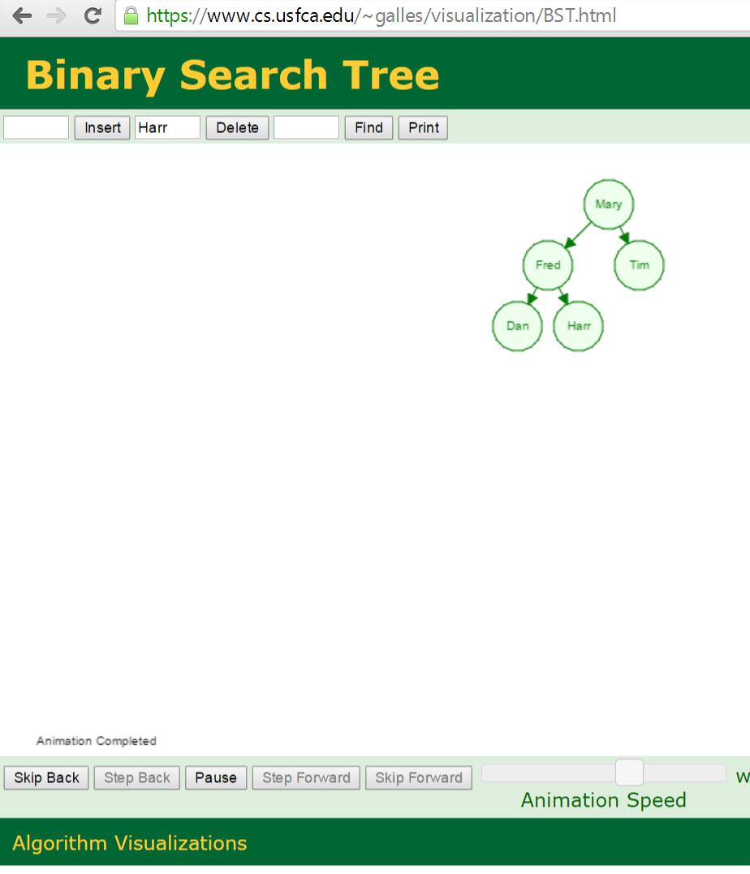
Sample of Binary Tree

Slide 39
Sorted Binary Tree
Mary
Fred
Tim
Dan
Harry
Pete
Walt
Alan
Ed
Greg
Keith
Nas
Sed
Vios
Zen
Now, apply In order traversal. It gives the result below:
Alan
Dan
Ed
Fred
Greg
Harry
Keith
Mary
Nas
Pete
Sed
Tim
Vios
Walt
Zen
Notice the names are in alphabetical order

Slide 40
ArrayList / Sorted List
System.Collections Namespace in MSDN
The System.Collections namespace contains interfaces and classes that define various collections of objects, such as lists, queues, bit arrays, hash tables and dictionaries.
Some useful data structures are:
ArrayList Implements the IList interface using an array whose size is dynamically increased as required.
SortedList Represents a collection of key/value pairs that are sorted by the keys and are accessible by key and by index
Find out more from the MSDN Web:
  http://msdn.microsoft.com/en-us/library/k166wx47.aspx
  About System.Collections Namespace
  Look into the Class definition, Constructor, Methods, Properties of ArrayList and SortedList
Understand how the data structure works.
It is useful for the project work

Slide 41
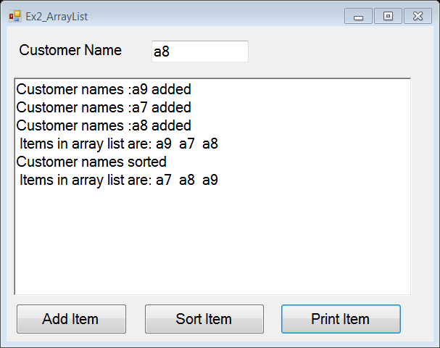
Example2:
Application of ArrayList
The advantage of using ArrayList:
It resizes itself when the array is out of storage space.
It provides method to sort ALL items in the arraylist.
But ArrayList are not used like standard arrays.
This example shows how to add an item (string CustomerName) using ArrayList.
Program reads in customer’s name
Implement a ArrayList class to do the following :
  Add item
  Sort item
  Print item

Slide 42
Example2:
Application of ArrayList
// To use ArrayList class
using System.Collections;
//create ArrayList object
ArrayList CustomerAL = new ArrayList();
private void BtnAddItem_Click(object sender, EventArgs e)
{
string custName = txtCustName.Text;
// add an item
CustomerAL.Add(custName);
rtbResult.AppendText("Customer names :" + custName + " added\n");
}
private void BtnSort_Click(object sender, EventArgs e)
{
CustomerAL.Sort(); // sort arraylist
rtbResult.AppendText("Customer names sorted\n");
}
private void BtnPrint_Click(object sender, EventArgs e)
{
rtbResult.AppendText(" Items in array list are: ");
// printing all items
foreach (string item in CustomerAL)
{
rtbResult.AppendText(item + " ");
}
rtbResult.AppendText("\n");
}

Slide 43
Practical 6:
Advanced Data Structures
1. There is a list of card numbers: 20 10 30 45 22 3
Complete the following tasks:
  Draw a sorted binary tree for the above nodes
  Traverse the sorted binary tree in inorder (LVR). Hints - the card numbers will be arranged in ascending order.
  Traverse the sorted binary tree in preorder (VLR)
  Traverse the sorted binary tree in postorder (LRV)

Slide 44
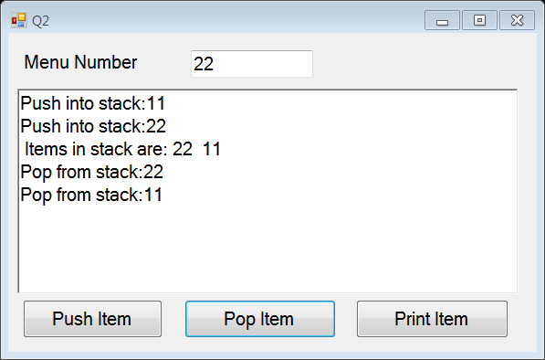
Practical 6:
Advanced Data Structures
2. An insurance company needs to have a stack object so that it can store the menu numbers that a customer has selected on their dial-up customer service hotline. Implement a stack to Push an order when it receives a menu number (int) and Pop the menu number when it is being served. It allows user to print the stack list too.
Create a window application using a stack object. It allows user to push or pop or print menu numbers on the stack.
Prompt error message when user attempts to pop an empty stack.
Hints:
  Visit the online MSDN library on how to apply STACK object
http://msdn.microsoft.com/en-us/library/system.collections.stack.aspx

Slide 45

Practical 7:
Advanced Data Structures
3. Knowing how the QUEUE and ARRAYLIST objects work, are you ready to apply these objects for your project?

Slide 46
IT1762
Data Structures & Algorithms
End of Topic 6
Advanced Data Structures

